Slide 1
Recurrent Neural Network (RNN)

Slide 2
Contents
Recurrent Neural Network (RNN)
Features of RNN
Feed forward Neural Network
Why RNN?
How does RNN work?
Different types of RNN
Common activation functions used in RNN
Issus in RNN
Applications
References

Slide 3
Recurrent Neural Network
A recurrent neural network (RNN) is a type of artificial neural network which uses sequential data or time series data.
These deep learning algorithm are commonly used for ordinal or temporal problems, such as:
language translation,
natural language processing (NLP),
speech recognition, and
image captioning.
They are incorporated into popular applications such as Siri, voice search, and Google Translate.

Slide 4
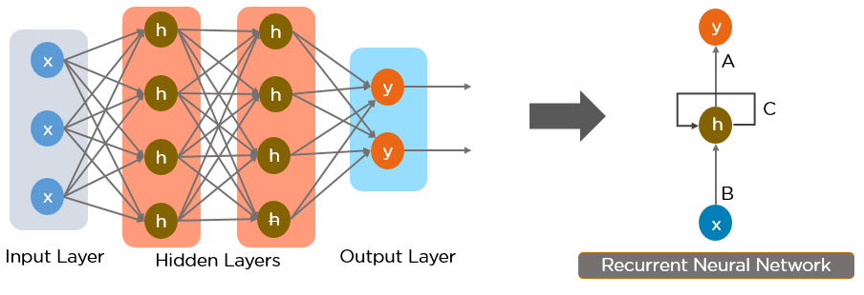
Recurrent Neural Network
A Recurrent Neural Network works on the principle of saving the output of a particular layer and feeding this back to the input in order to predict the output of the layer.

Slide 5
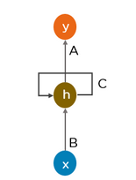
Features of RNN
The main and most important features of RNN are:
Includes weighted connections within a layer
Includes weighted connections within a layer
Having loops which can store information
Having hidden state, which remembers some information about a sequence.
Having “memory” which remembers information about what has been calculated.
Uses the same parameters for each input or hidden layers
Reduces the complexity of parameters.

Slide 6
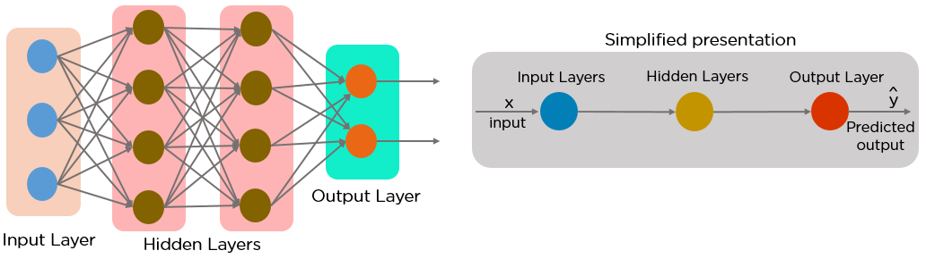
Feed-Forward Neural Network
It allows information to flow only in the forward direction, from the input nodes, through the hidden layers, and to the output nodes. There are no cycles or loops in the network.

Slide 7
Feed-Forward Neural Network
The decisions are based on the current input. It doesn’t memorize the past data, and there’s no future scope. They are used in general regression and classification problems.

Slide 8
Why Recurrent Neural Networks?
Recurrent neural networks were created because there were a few issues in the feed-forward neural network:
Cannot handle sequential data
Considers only the current input
Cannot memorize previous inputs
The solution to these issues is the Recurrent Neural Network (RNN).
A RNN can :
handle sequential data,
accept the current input data, and previously received inputs.
memorize previous inputs due to their internal memory.

Slide 9
How does RNN work?
Suppose, there is a deeper network with one input layer, three hidden layers and one output layer. Each hidden layer have its own set of weights and biases, let’s say, for hidden layer 1 the weights and biases are (w1, b1), (w2, b2) for second hidden layer and (w3, b3) for third hidden layer. This means that each of these layers are independent of each other, i.e. they do not memorize the previous outputs
Output
Input
w1,b1
w2,b2
w3,b3
Hidden Layer

Slide 10
RNN works…
Now the RNN will do the following:
RNN converts the independent activations into dependent activations by providing the same weights and biases to all the layers, thus reducing the complexity of increasing parameters and memorizing each previous outputs by giving each output as input to the next hidden layer.
Hence these three layers can be joined together such that the weights and bias of all the hidden layers is the same, into a single recurrent layer.
w1,b1
w1,b1
w1,b1
Output
Input
Hidden Layer

Slide 11
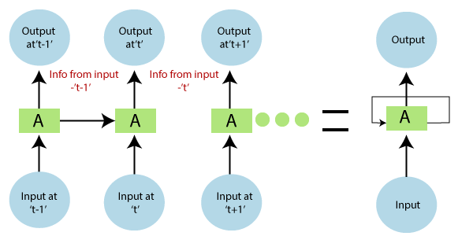
RNN works…
In the above diagram, we have specific inputs at t-1, which is fed into the network. These inputs will lead to parallel outputs at time 't-1' as well.
In the next timestamp, information from the previous input’ t-1 is provided along with input at ’t to provide the output at 't eventually.'
This process repeats itself, to ensure that the latest inputs are aware and can use the information from the previous timestamp is obtained.

Slide 12
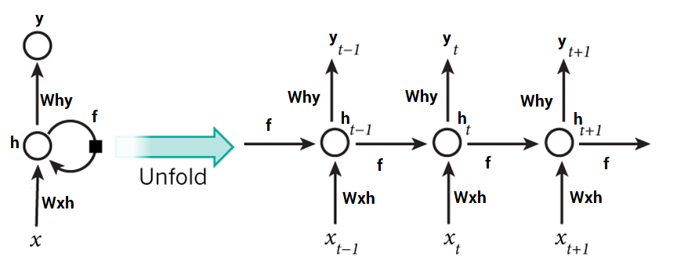
Steps in RNN
A single time step of the input is supplied to the network
i.e. X_{t} is supplied to the network
Calculate its current state using a combination of the current input and the previous state i.e. we calculate h_{t}
h_{t} =f(h_{t-1}, X_{t})
Current h_{t} becomes h_{t-1} for the next time step
Then, go as many time steps as the problem demands and combine the information from all the previous states
After completing the final state, current state is used to calculate the output Y_{t}
Y_{t} = W_{hy}h_{t}
Output is then compared to the actual output and the error is generated
The error is then backpropagated to the network to update the weights and the network is trained

Slide 13
RNN works…
For calculating the current state-
h_{t} =f(h_{t-1}, X_{t})
where, h_{t}= current state H_{t-1}= previous state X_{t}= input state
To apply the activation function tanh, we have-
ht = tanh (W_{hh}h_{t}-1+ W_{xh}X_{t})
where, W_{hh} = weight of recurrent neuron and, W_{xh} = weight of the input neuron
The formula for calculating output:
Y_{t} = W_{hy}h_{t}

Slide 14
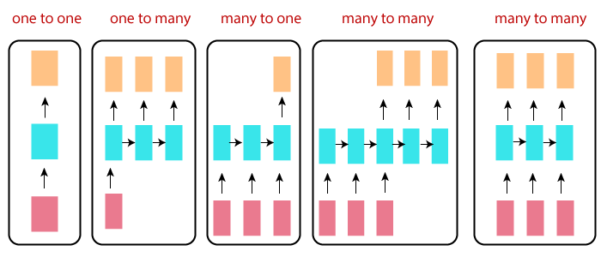
Different types of RNN
Recurrent nets are more exciting is that they allow us to operate over sequences of vectors: Sequence in the input, the output, or both.

Slide 15
Explanation
One-to-one:
This is also called Plain Neural networks. It deals with a fixed size of the input to the fixed size of output, where they are independent of previous information/output.
Example: Image classification.
One-to-Many:
It deals with a fixed size of information as input that gives a sequence of data as output.
Example: Image Captioning takes the image as input and outputs a sentence of words.
Many-to-One:
It takes a sequence of information as input and outputs a fixed size of the output.
Example: sentiment analysis where any sentence is classified as expressing the positive or negative sentiment.

Slide 16
Explanation
Many-to-Many:
It takes a Sequence of information as input and processes the recurrently outputs as a Sequence of data.
Example: Machine Translation, where the RNN reads any sentence in English and then outputs the sentence in French.
Bidirectional Many-to-Many:
Synced sequence input and output.
Example: Video classification where we wish to label every frame of the video.

Slide 17
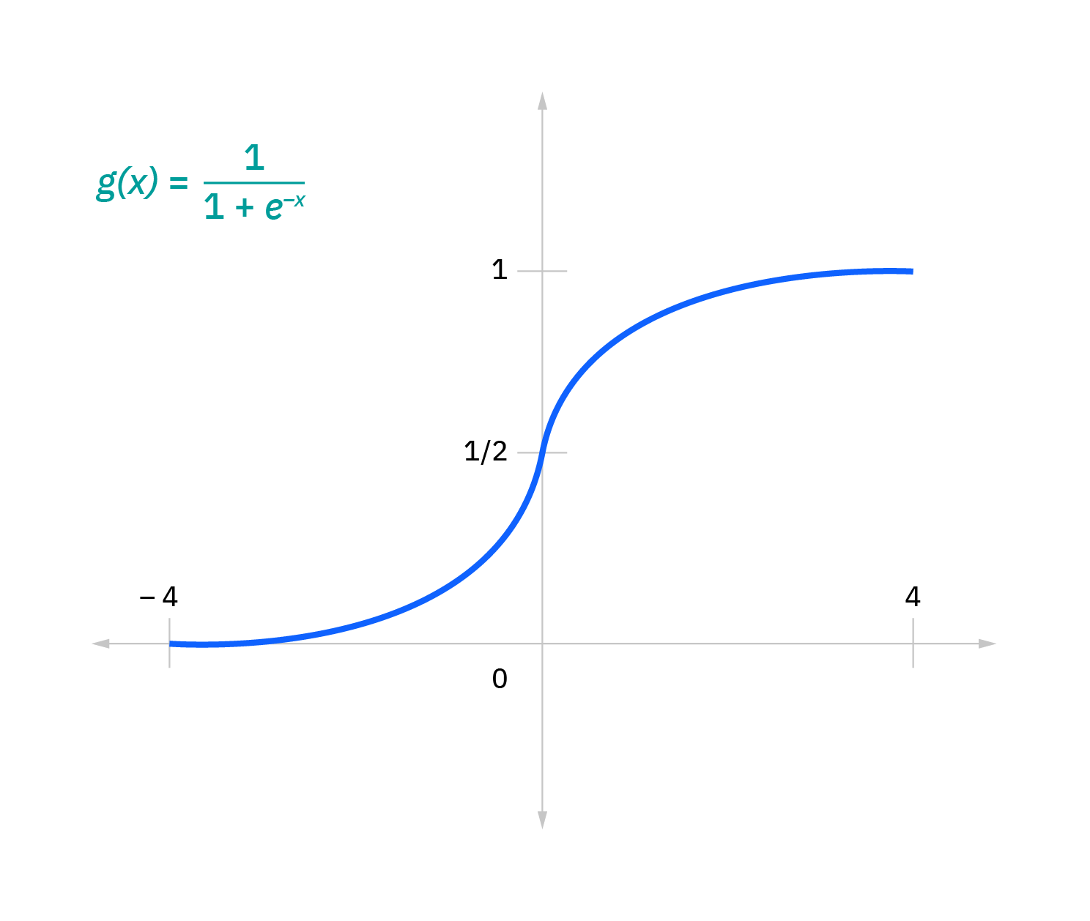
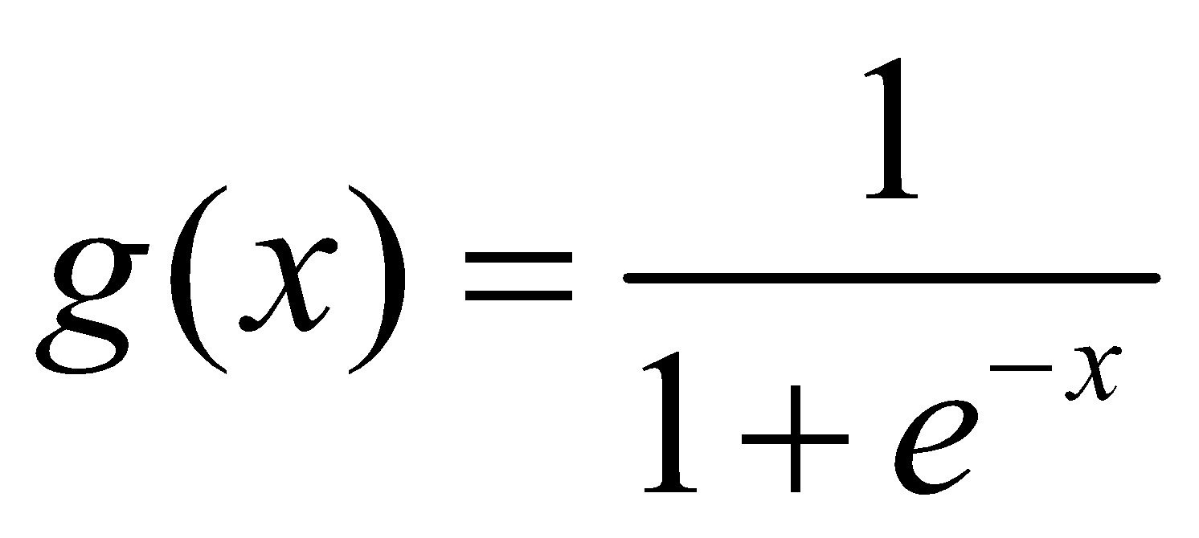
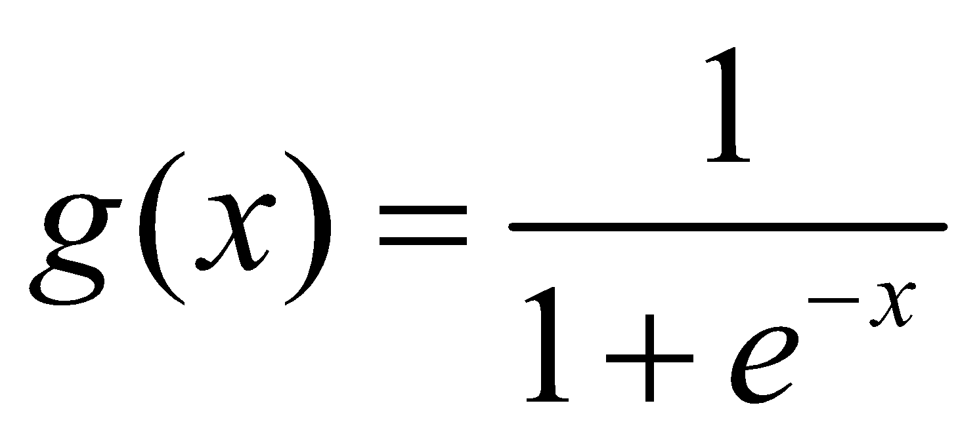
Common Activation Functions
An activation function determines whether a neuron should be activated. The nonlinear functions typically convert the output of a given neuron to a value between 0 and 1 or -1 and 1.
Some of the most commonly used functions are defined as follows:
Sigmoid
ReLU
Tanh
Sigmoid: This is represented with the formula:

Slide 18
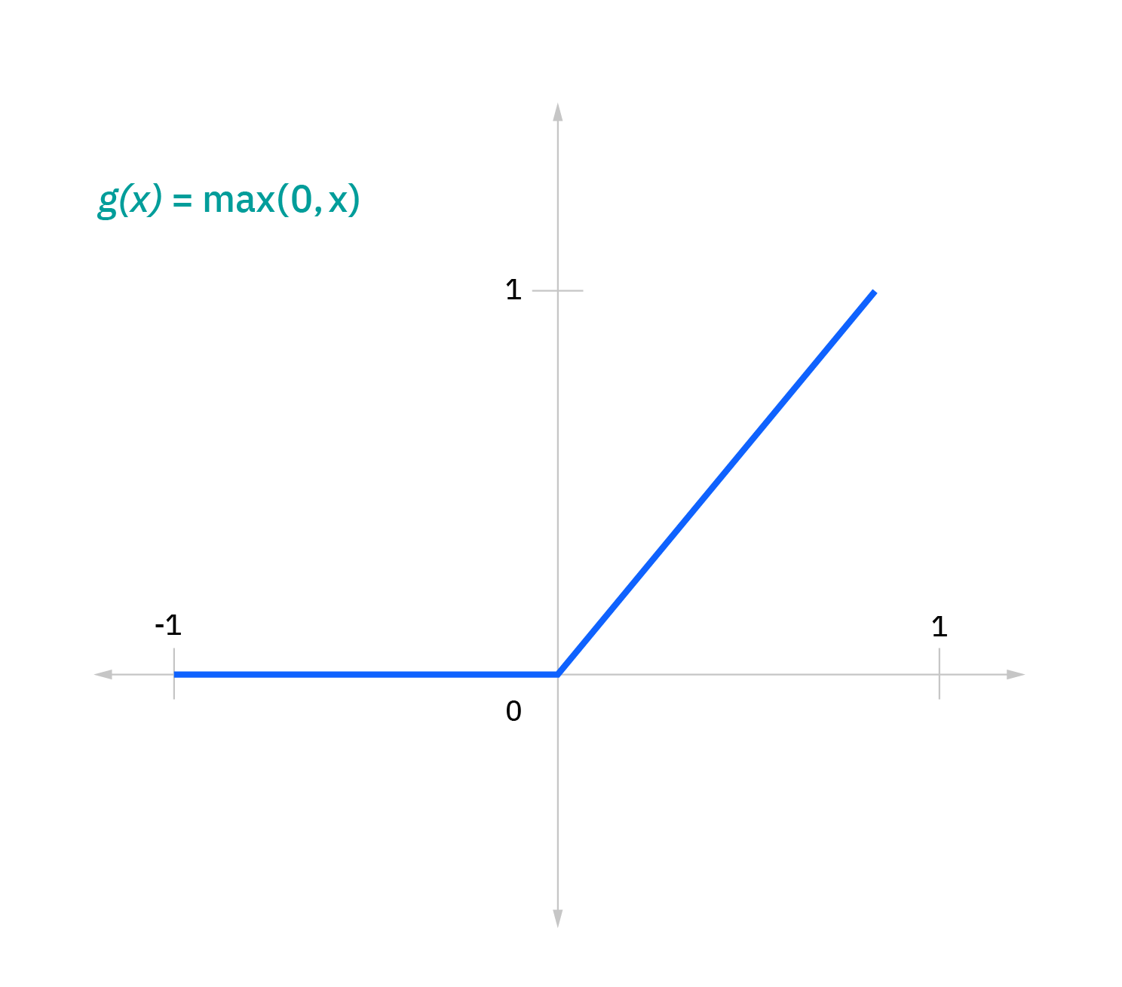
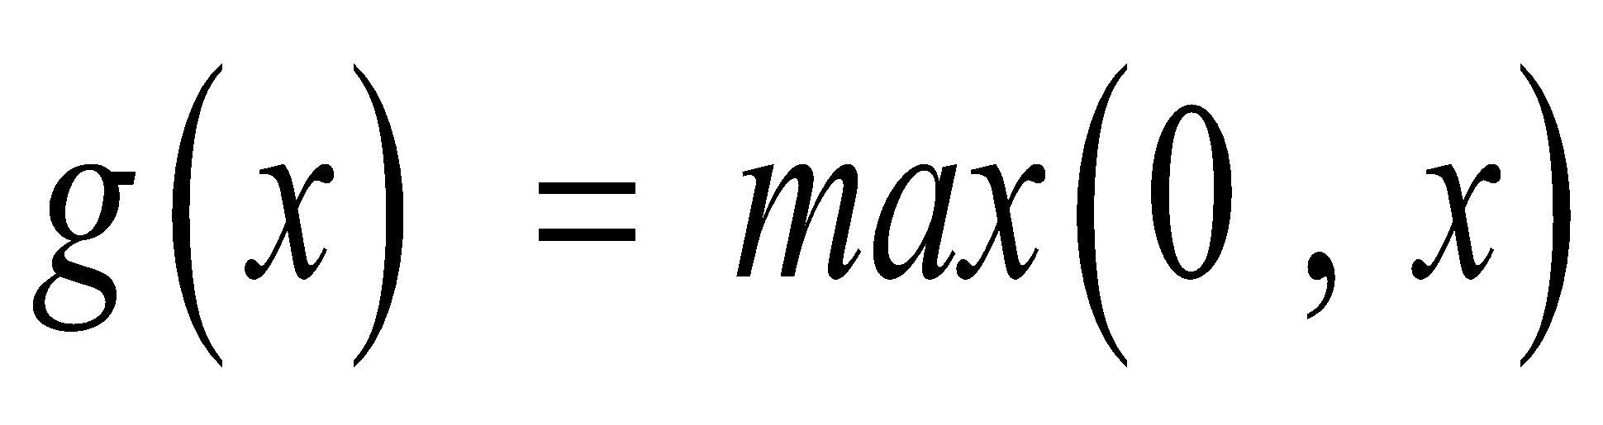

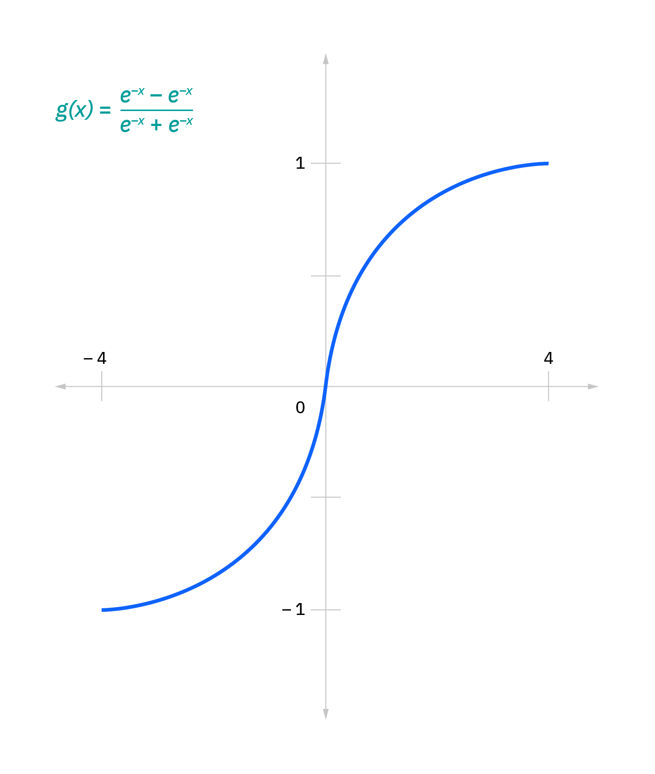
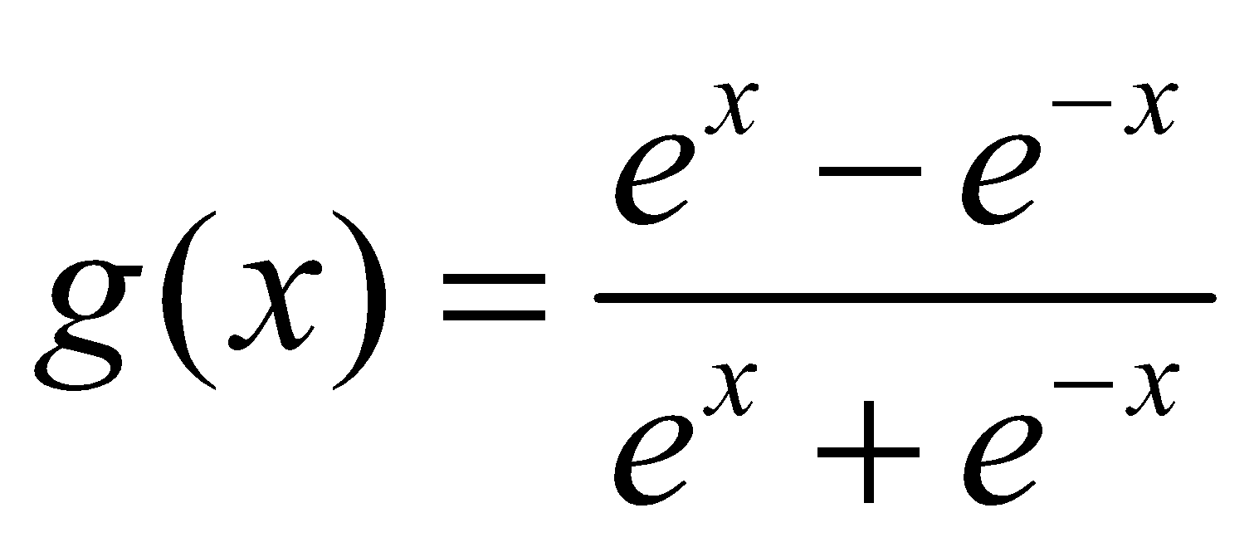
Common Activation Functions
ReLU: This is represented with the formula:
g(x) = max(0 , x)
Tanh: This is represented with the formula

Slide 19

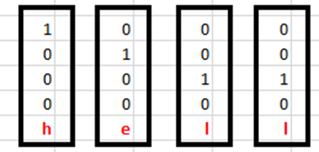
Understanding a Recurrent Neuron in Detail
Let’s take a look at the inputs first. The inputs are one hot encoded. Our entire vocabulary is {h,e,l,o} and hence we can easily one hot encode the inputs.

Slide 20
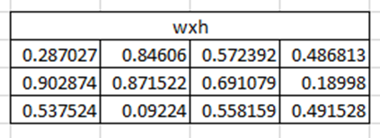
Understanding a Recurrent Neuron in Detail
Now the input neuron would transform the input to the hidden state using the weight wxh. We have randomly initialized the weights as a 3*4 matrix

Slide 21
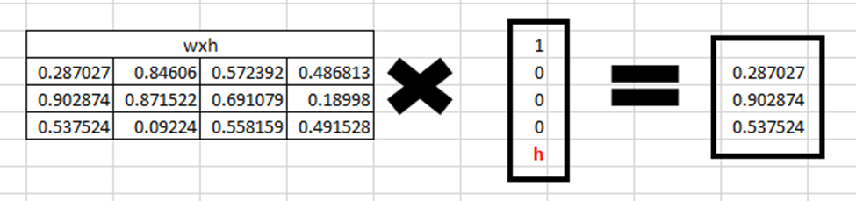
RNN Example
Step 1: Now for the letter “h”, for the the hidden state we would need Wxh*Xt. By matrix multiplication, we get it as –

Slide 22


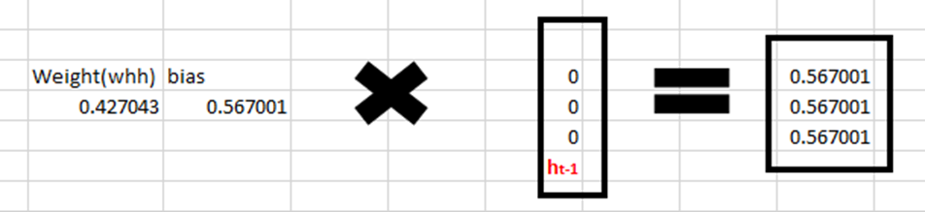
RNN Example
Step2: Now moving to the recurrent neuron, we have Whh as the weight which is a 1*1 matrix and the bias which is also a 1*1 matrix =
For the letter “h”, the previous state is [0,0,0] since there is no letter prior to it. So to calculate -> (Whx* Xt-1+(whh*ht-1+bias))
Read the docx file for the rest of portion of this example

Slide 23
Issues in RNN
A gradient is a partial derivative with respect to its inputs. A gradient measures how much the output of a function changes if you change the inputs a little bit (slop).
Exploding Gradients
Exploding gradients are when the algorithm, without much reason, assigns a stupidly high importance to the weights. Fortunately, this problem can be easily solved by truncating or squashing the gradients.
Vanishing Gradients
Vanishing gradients occur when the values of a gradient are too small and the model stops learning or takes way too long as a result.. Fortunately, it was solved through the concept of LSTM.

Slide 24
Training Recurrent Neural Networks
Recurrent Neural Networks use backpropagation algorithm for training, but it is applied for every timestamp. It is commonly known as Back-propagation Through Time (BTT).
There are some issues with Back-propagation such as:
Vanishing Gradient
Exploding Gradient
Let us consider each of these to understand what is going on

Slide 25
Vanishing Gradient
When making use of back-propagation the goal is to calculate the error which is actually found out by finding out the difference between the actual output and the model output and raising that to a power of 2.
Consider the following diagram:

Slide 26
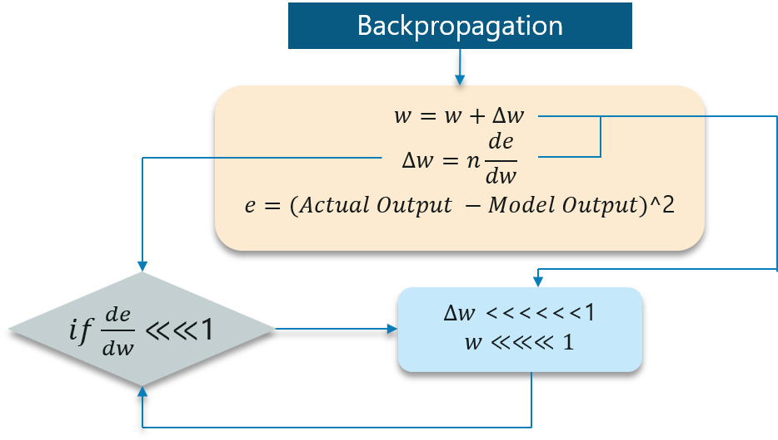
Cont.
With the error calculated, the changes in the error with respect to the change in the weight is calculated. But with each learning rate, this has to be multiplied with the same.
So, the product of the learning rate with the change leads to the value which is the actual change in the weight.
This change in weight is added to the old set of weights for every training iteration as shown in the figure. The issue here is when the change in weight is multiplied, the value is very less.

Slide 27

Exploding Gradient
The working of the exploding gradient is similar but the weights here change drastically instead of negligible change. Notice the small change in the diagram below:

Slide 28
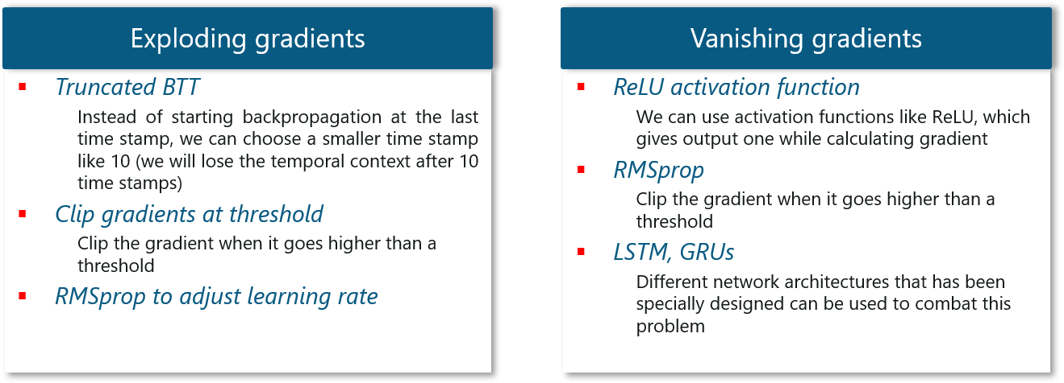
Cont.
We need to overcome both of these and it is a bit of a challenge at first. Consider the following chart:

Slide 29
Pros and Cons of RNN
Pros
RNN can model a sequence of data so that each sample can be assumed to be dependent on previous ones.
It can even used with convolutional layers to extend the active pixel neighbourhood.
Cons
Gradient vanishing and exploding problems.
Training on RNN is a complicated task.
It could not process very long sequences if it were using tanh or ReLU like an activation function.

Slide 30
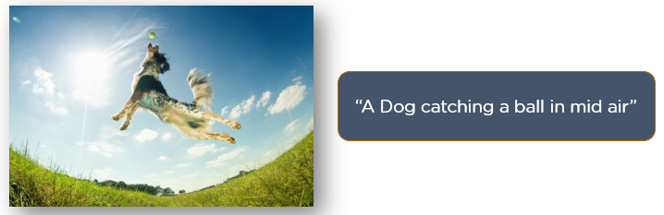
Applications
Image Captioning
RNNs are used to caption an image by analysing the activities present.

Slide 31

Applications
Machine Translation
Given an input in one language, RNNs can be used to translate the input into different languages as output.

Slide 32
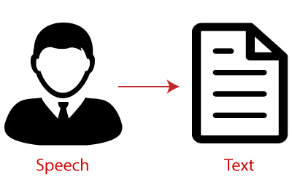
Applications
Speech Recognition
Given an input voice in one language, RNNs can be used to recognize it and convert it into text format as output.

Slide 33
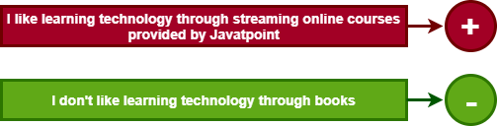
Applications
Sentiment Analysis
Given an input text ,RNNs can be used to analyse it and convert it into sentiment types (positive or negative).

Slide 34
References
https://www.ibm.com/cloud/learn/recurrent-neural-networks
https://developer.ibm.com/technologies/artificial-intelligence/articles/cc-cognitive-recurrent-neural-networks/
https://www.simplilearn.com/tutorials/deep-learning-tutorial/rnn
https://www.javatpoint.com/recurrent-neural-network-in-tensorflow
https://dataaspirant.com/how-recurrent-neural-network-rnn-works/

Slide 35
THANKS ALL

